Slide 1
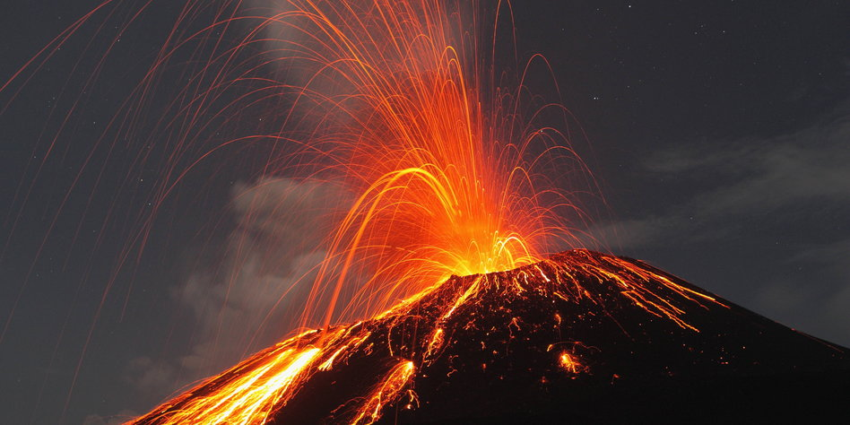

Effects of volcanic forcing on global mean temperature
Pierre Testorf, David Becker, Mohammad Basir Uddin, Gunay Najafzade

Slide 2
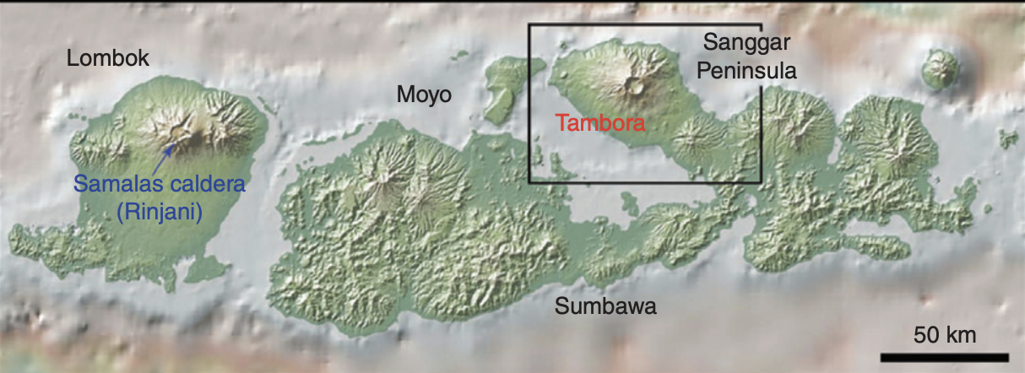
Tambora eruption 1815
In April 1815, the volcano Tambora on the Indonesian island of Sumbawa erupted violently and caused a decrease in surface temperature on a global scale.
Map: location of Tambora and Rinjani, the sites of the probably two largest eruptions of the last millennium. The map was generated using GeoMapApp©. Raible et al, 2016.
This is due to the injection of sulfate aerosols, fine ash and volatiles into the stratosphere during the eruption that inhibit some of the short wave radiation to reach the Earth’s surface.
It produced that shielded incoming solar radiation over the following 3 years.

Slide 3
Study questions:
How is the cooling affected by the different eruption intensities and lengths?
Can the effects of the eruption be represented by implementing a decrease in solar constant in 0-D EBM?

Slide 4

1. How is the cooling affected by the different eruption intensities and lengths?
Method: Implementing a decrease in the solar constant representing effects of the eruption. The effects of volcanic forcing are modeled in 0-d EBM through changes in 𝑆₀ with respect to time.
Assumptions:
Variables: T_{s} , S₀
S₀ (t)
Albedo: alpha = 0.3
Height: H = 70.0
Emissivity: eps = 0.61

Slide 5
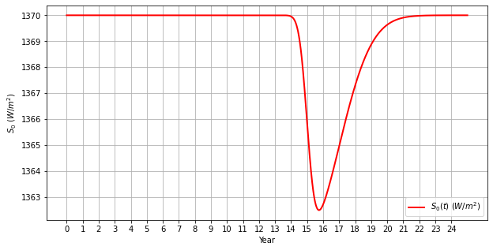
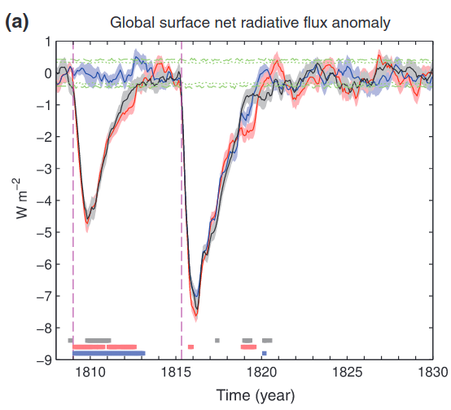
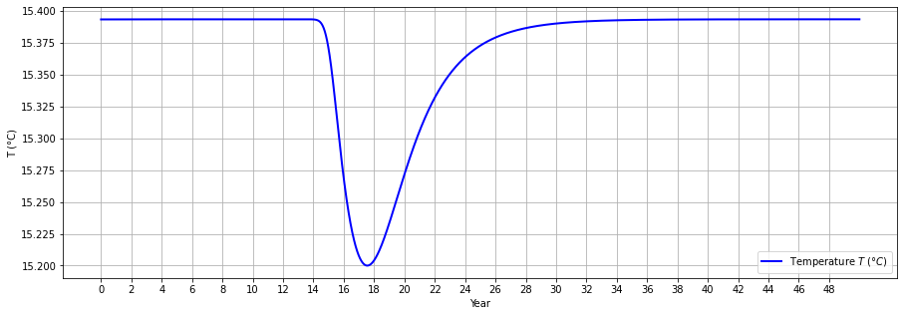
Methodology: The effect of volcanic activity is modelled by adding a Gaussian-shaped dip in the solar constant and temperature.
Raible et al., 2016

Slide 6
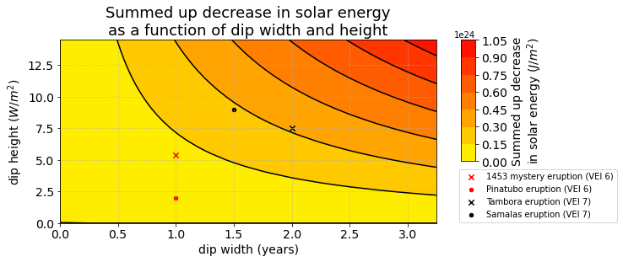
The effects of characteristics (width and height) of the dip on the cumulative decrease in solar energy.

Slide 7
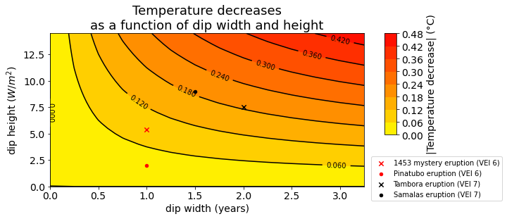
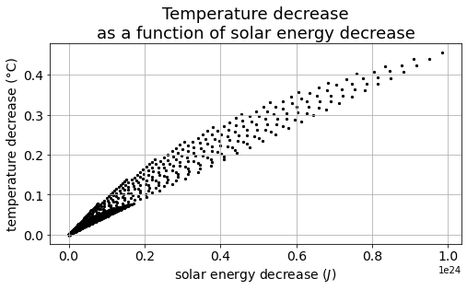
The decrease in surface temperature based on characteristics of the dip, namely the width and height.
While temperature decrease is related to the total sun energy decrease, the feedback time can't only be described by it. The eruption length (width) is more important than the amplitude.

Slide 8
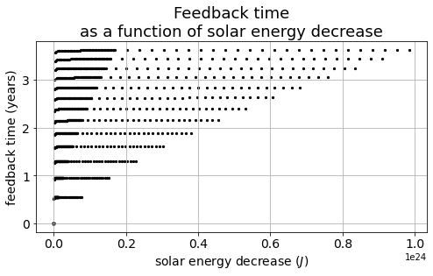
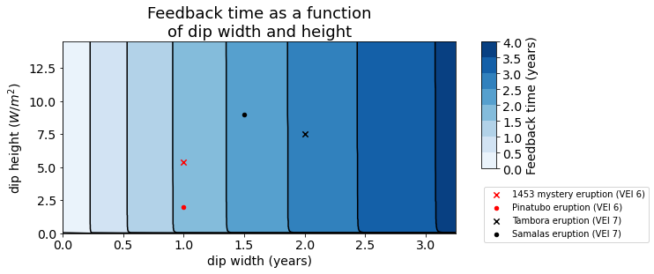
The feedback time as a function of eruption length and intensity.
The dip width has the strongest influence on the change of the feedback time.

Slide 9
2. Can the effects of the eruption be represented by implementing a decrease in solar constant in 0-D EBM?
Method: Comparison with other papers.
Eruption Name | Eruption Year | Temp. Decrease (°C) | Our Findings (°C)
Tambora (VEI-7) | 1815 | 2.5 | 0.2
Pinatubo (VEI-6) | 1991 | 0.5 | 0.03
Samalas (VEI-7) | 1257 | 2.88 | 0.2
Mystery eruption (VEI-6) | 1453 | 2.8 | 0.08

Slide 10
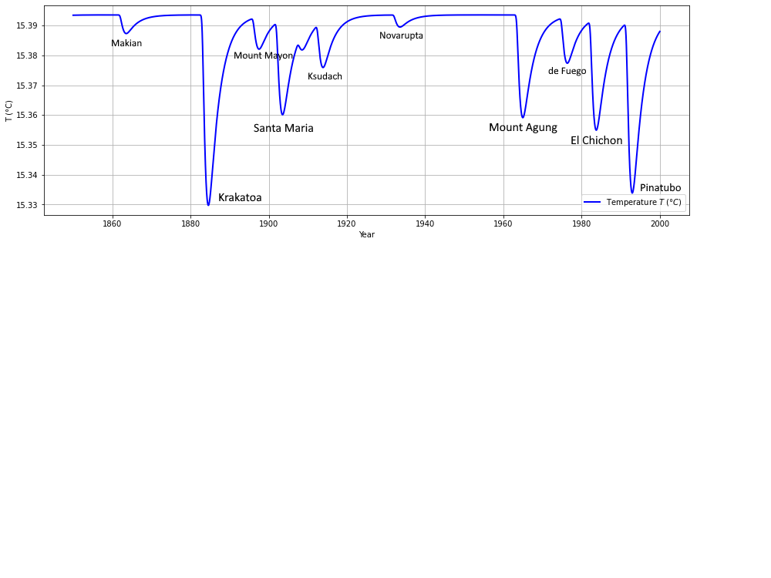


Method: Simulating time series of temperature change induced by major volcanic eruptions based on Aerosol Optical Depth data.
Bindoff et al., 2013 (AR5, WG1, chapter 10)
(Andersson et al., 2014)

Slide 11
Limitations:
0-d vs. 3-d
Latitudinal and seasonal dependence not considered
Response depends highly on aerosol behaviour
Neglection of atmospheric responses
Conclusions:
Feedback time (dip width)
Temperature response (dip width, dip height)
The expected temperature decrease is ~10x lower

Slide 12
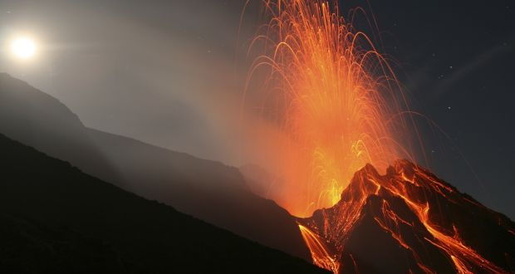
Thanks for your attention!

